Slide 1
Introducing NCRC
Adoption Information Disclosure
Post Adoption Services
Enactments & Amendments of the Adoption Act
(JULY, 2025)
CONTENTS

Slide 2
Introducing NCRC

Slide 3
1. Introducing NCRC
1) National Center for the rights of the Child
Legal Ground
Article 10-2 of the Child Welfare Act
(Establishment and Operation of the NCRC)
Purpose
Implement child policies, support the development of necessary policies to effectively carry out child-related projects and conduct assessments accordingly.

Slide 4
1. Introducing NCRC
1) National Center for the rights of the Child
~2019.07.15
Korea Adoption Services
2019.01.15.
Proclaimed the revised Child Welfare Act to establish the NCRC
Revision of Child Welfare Act to allow foundation of the NCRC announced
2019.07.16.
Founded as the NCRC and completed 1st integration of child welfare institutions
Korea Adoption Services, Province Self-reliance Support Team,
Dream Start Support Team, National Center for Missing Children
2020.01.01.
Integration of child welfare institutions under NCRC completed
Child Development Account Support Team, Central Foster support center,
Central Child Care institution, Headquarter of Community Child Center
2020.01.29.
Designated as a “Non-Classified Public Institution”
Ministry of Economy and Finance

Slide 5
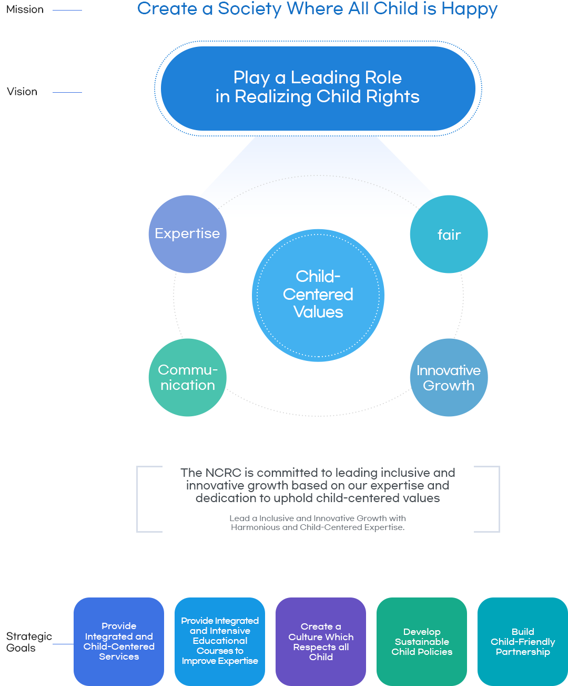
1. Introducing NCRC
1) National Center for the rights of the Child
Core Values

Slide 6
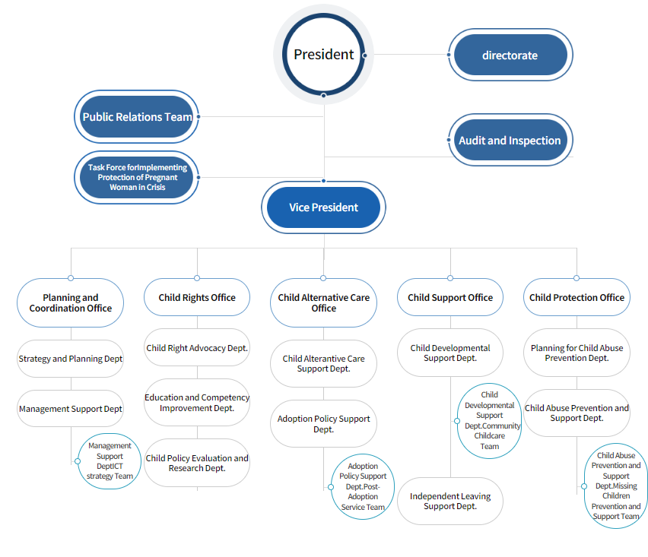
1. Introducing NCRC
1) National Center for the rights of the Child

Slide 7
1. Introducing NCRC
2) Adoption Policy Support Dept. Post-Adoption Service Team
Adoption Policy Support Dept.
Assist in enacting and amending adoption laws
Preparing ratification of Hague Adoption Convention
Developing Adoption Procedure Manual
Assist in operating Adoption Matching Committee
Educate prospective adoptive parents
Promotion for improving public awareness of adoption

Slide 8
1. Introducing NCRC
2) Adoption Policy Support Dept. Post-Adoption Service Team
Post-Adoption Service Team
Adoption Information Disclosure and Searching for Birth Parents
Post Adoption Services (Overseas / Domestic)
Permanent Preservation of Adoption-related Records
Operation of an integrated adoption management system

Slide 9
2. Adoption Information Disclosure
(Searching for Birth Parents)

Slide 10
2. Adoption Information Disclosure
1) Adoption Information Disclosure Overview
Legal Grounds
Act on Special Cases Concerning Adoption Article 36, Enforcement Ordinance Articles 13~17 of the Same Law,
Enforcement Regulation Articles 29~30 under the Same Law
- Act on Special Cases Concerning Adoption Article 36 ( Disclosure of Information on Adopted Children, etc. )
① A person who has been adopted under this Act may request disclosure of information on his/her adoption
which is held by the NCRC or the relevant adoption agency
: Provided, That if a person who has been adopted under this Act is a minor, he/she shall obtain consent thereto from his/her adoptive parents.
Objective
Adoption Information Disclosure request process aims to facilitate the search of birth families,
strengthen self-identity, and ensure the right to know of adoptees.
Eligibility
Person who has been adopted under the 「Act on Special Cases Concerning Orphan Adoption」, 「Act on Special Cases Concerning Adoption Promotion and Procedures」, and 「Act on Special Cases Concerning Adoption」
* (age 19 and over) direct request allowed / (under age 19) consent from adoptive parents is required

Slide 11
2. Adoption Information Disclosure
1) Adoption Information Disclosure Overview
Disclosed Information
Adoption background information, Information of birth parents (Enforcement Ordinance Article 13)
▷ Age of birth parents at the time of adoption
▷ Adoption date & reason for relinquishment
▷ Place of residence of birth parents at the time of adoption (city · county · district)
▷ Name, address, and contact information of the adoption facility or agency
where the adoptee was under care before the adoption
▷ Adoption information that the Minister of Health and Welfare deems necessary to disclose
▷ Name, date of birth, address, and contact information of birth parents at the time of adoption
(disclosed after obtaining the consent of the birth parents)

Slide 12
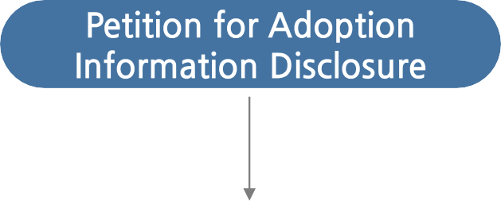
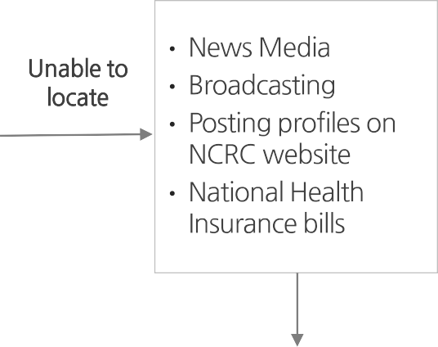
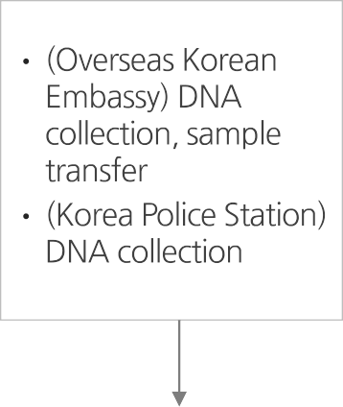
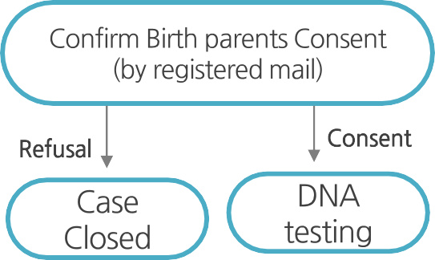
2. Adoption Information Disclosure
2) Adoption Information Disclosure Process
1
2

Slide 13
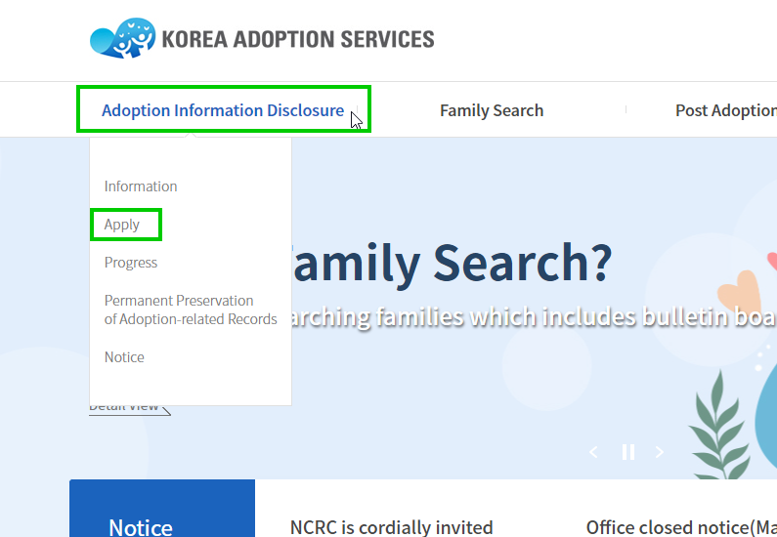
2. Adoption Information Disclosure
2) Adoption Information Disclosure Process
① Petition for Adoption Information Disclosure
Required Documents :
Adoption Information Disclosure Request Form
Copy of identification
(resident registration card, passport, or alien registration card)
To apply : Submit the form on the website(www.kadoption.or.kr)
Petition for Adoption Information Disclosure (Top tab)
Submit a request
② Verify adoption background information of the applicant
Use adoption records and verify information eligible for disclosure
under the Act on Special Cases Concerning Adoption
* Adoption records are currently stored & managed by each adoption agency

Slide 14
2. Adoption Information Disclosure
2) Adoption Information Disclosure Process
③ If personal information of natural parents can be verified
Locate the birth parents
(search on Public Information Sharing System & request cooperation of local authorities and public agencies)
Confirm consent of birth parents to information disclosure (via registered mail or telegram (up to 3 times))
(With birth parents’ consent) Disclose information and facilitate the reunion with birth parents
(Without birth parents’ consent) Disclose adoption background information of the adoptee (including the place of residence of birth parents at the time of adoption)
④ If personal information of natural parents cannot be verified
Disclose adoption background information of the adoptee (including the place of residence of birth parents
at the time of adoption)
Support non-identified adoptees with DNA registration, press coverage, Family Search Bulletin Board, and more.

Slide 15
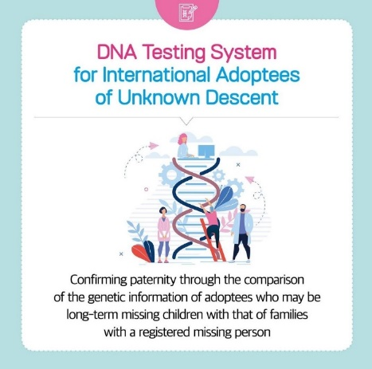
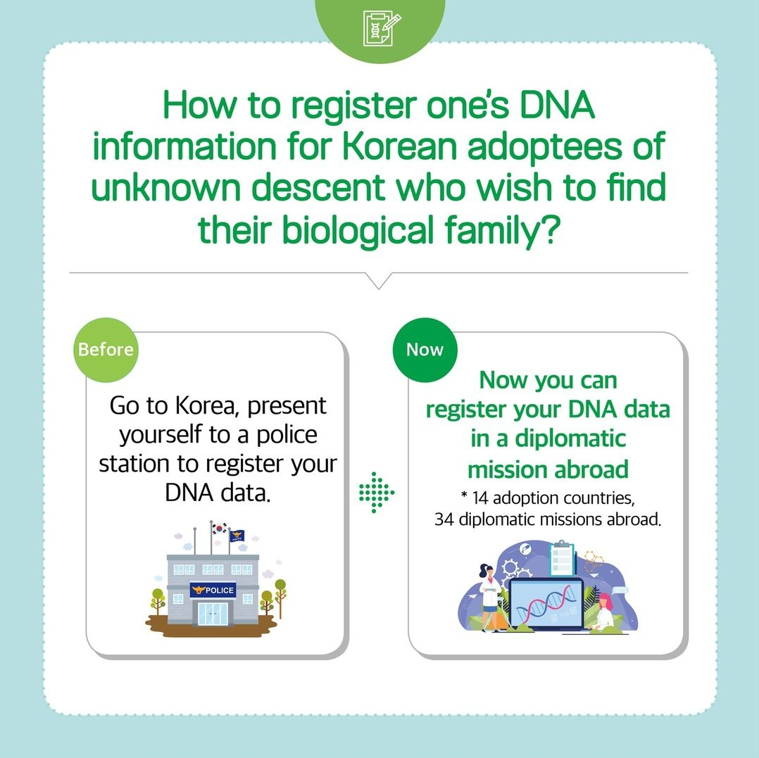
2. Adoption Information Disclosure
2) Adoption Information Disclosure Process
⑤ DNA Registration of non-identified adoptees to the overseas diplomatic offices
(Subjects) DNA registration of non-identified adoptees can be made to the police station in Korea
in accordance with the Act on the Protection and Support of Missing Children.
(Legal Grounds) Article 11 of the Act on the Protection and Support of Missing Children
(Registration Process)
Submit application form (by adoptee)
Issue confirmation statement of non-identified adoptees (NCRC → adoptees)
Request for DNA sample from non-identified adoptees (NCRC → overseas diplomatic offices)
DNA sample collection (overseas diplomatic offices ↔ adoptees)
Inform whether DNA sample is collected or not (overseas diplomatic offices → NCRC)
Send/register DNA samples (overseas diplomatic offices ↔ National Police Agency/National Forensic Service)
* Download application form: www.kadoption.or.kr/en/info/dna_test.jsp
** Submit application to familysearch@ncrc.or.kr
Notes:
1. Discussions are currently underway to expand the scope of those being DNA tested.
2. Expand the scope of DNA matching from biological parents to siblings.

Slide 16
2. Adoption Information Disclosure
2) Adoption Information Disclosure Process
⑦ Inquiries on the Process
National Center for the Rights of the Child(NCRC) : familysearch@ncrc.or.kr
Korea Welfare Services(KWS) : swspas@kws.or.kr
Eastern Social Welfare Society(ESWS) : postadoption@eastern.or.kr
Korea Social Service, Inc.(KSS) : kssinc@kssinc.org
Holt Children’s Services, Inc.(Holt) : pasc@holt.or.kr

Slide 17
3. Post Adoption Services

Slide 18
3. Post Adoption Services
Purpose
To support life cycle services in accordance with the needs of child and adult overseas adoptees and their families, ensuring healthy growth, development and settlement
※ Legal grounds: Special Adoption Act, Article 3 (Duties of the State) and Article 25 (Furnishing of Post Adoption Services)
Objectives
Linking overseas adoptees (and adoptive families) to birth country culture to help establish identity
Building social support networks for overseas adoptees and building community capacities
Promoting the interests of overseas adoptees, including acquisition of citizenship
Psychological and emotional support for overseas adoptees (and adoptive families)
Support System

Slide 19
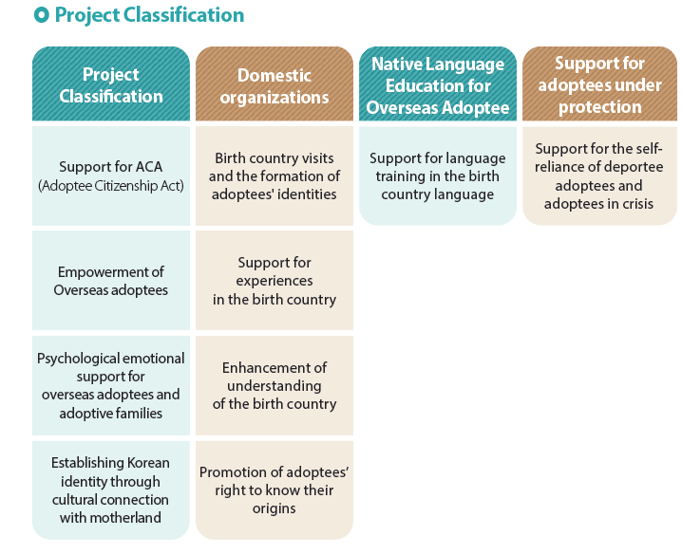
3. Post Adoption Services
Classification
Overseas
Organizations

Slide 20
3. Post Adoption Services
Integrated Services for Adoptees Under Protection
Purpose
Providing independent living and settlement support to overseas adoptees
who wish to acquire nationality and settle in Korea through integrated services
Providing integrated services to deported overseas adoptees and overseas adoptees
residing in Korea who are facing social, economic, and emotional crises
to support their settlement in Korea and independence, and to mitigate crises
Expected Effects

Slide 21
4. Enactments & Amendments
of the Adoption Act

Slide 22
4. Enactments & Amendments of the Adoption Act
Amendments
Proposed Amendment of the 「Special Act on Domestic Adoption」
Proposed Legislation of the 「Act on Intercountry Adoption」
Proposed Amendment of the 「Child Welfare Act」
were passed at the National Assembly Plenary Session (June 30, 2023)
Effective Date
July 19, 2025

Slide 23
4. Enactments & Amendments of the Adoption Act
Key Details
Strengthened responsibility, management, and supervision of the national government and local authorities for the overall process of child adoption
Intercountry adoption is carried out only in cases where it is in the best interests of the child who cannot find adoptive parents domestically, and all intercountry adoptions including child under protection or from internationally remarried families follow the Hague Convention procedures (central authority : the Ministry of Health and Welfare)
Management of adoption records and all tasks related to the disclosure of adoption information are centralized under the NCRC and expand the scope of DNA matching from biological parents to siblings

Slide 24
4. Enactments & Amendments of the Adoption Act
Important changes to the Domestic Adoption Process
due to the Amendment of the Special Act on Domestic Adoption
 | Before | After
Decision & Protection for Adoptable Child | Local Authorities | Local Authorities
 | Private Adoption Agency
Counselling & Education for Prospective Adoptive Parents, Post-adoption Management | Private Adoption Agency | The Ministry of Health & Welfare (can be delegated to specialized institutions)
Core Procedures including Prospective Adoptive Parent Assessment & Matching | Private Adoption Agency | The Ministry of Health & Welfare Adoption Policy Committee (chairperson: the Minister of Health and Welfare)
Decision on Temporary Care (New) ※Program to facilitate early bonding and mutual adjustment of prospective adoptive parents and child before the adoption approval | - | Family Court
Manage Adoption Records & Disclose Information | Private Adoption Agency | NCRC
 | NCRC

Slide 25
Q&A

Slide 26
Thank you ☺

